Slide 1
Progress Presentation
Multi-factor transaction authorisation based on QR code
Presented By: FYP-23-S1-02
Notes:
Belinda Good Morning Sir, we are the FYP group S1-02 and our FYP topic is on “multi-factor transaction authorisation based on QR code”. This is our progress presentation. Joining me today are my team members: Angela, Benisha, Jia Hong and Young Suh. I am Belinda and I will be starting us off!

Slide 2
Understanding the Topic
What is Multi-factor transaction authorization?
A security measure that requires users to provide multiple forms of authentication in order to authorize a transaction
Provides an additional layer of security to prevent unauthorized access
Notes:
Belinda So what is a Multi-factor transaction authorization? It is A security measure that requires users to provide multiple forms of authentication in order to authorize a transaction. This approach is used to provide an additional layer of security to prevent unauthorized access
Well then what is a QR code?
It is a type of two-dimensional barcode that can be easily read by a smartphone camera or a QR code scanner that can also be used for authentication purposes which is what we will be focusing on.

Slide 3
Understanding the Topic
What is a QR code?
A type of two-dimensional barcode that can be easily read by a smartphone camera or a QR code scanner
They can also be used for authentication purposes
How can QR code be used for multi-factor transaction authorization?
User will be able to scan the QR code with a trusted device/app to verify the transaction details
Notes:
Belinda
Well then what is a QR code?
It is a type of two-dimensional barcode that can be easily read by a smartphone camera or a QR code scanner that can also be used for authentication purposes which is what we will be focusing on.
So how can QR codes be used for MFA? QR is just one of many ways we can use to an extra layer of security in a MFA system by letting the user scan the QR code with a trusted device/app which they have already logged on to with their login credentials, to verify the transaction details.

Slide 4
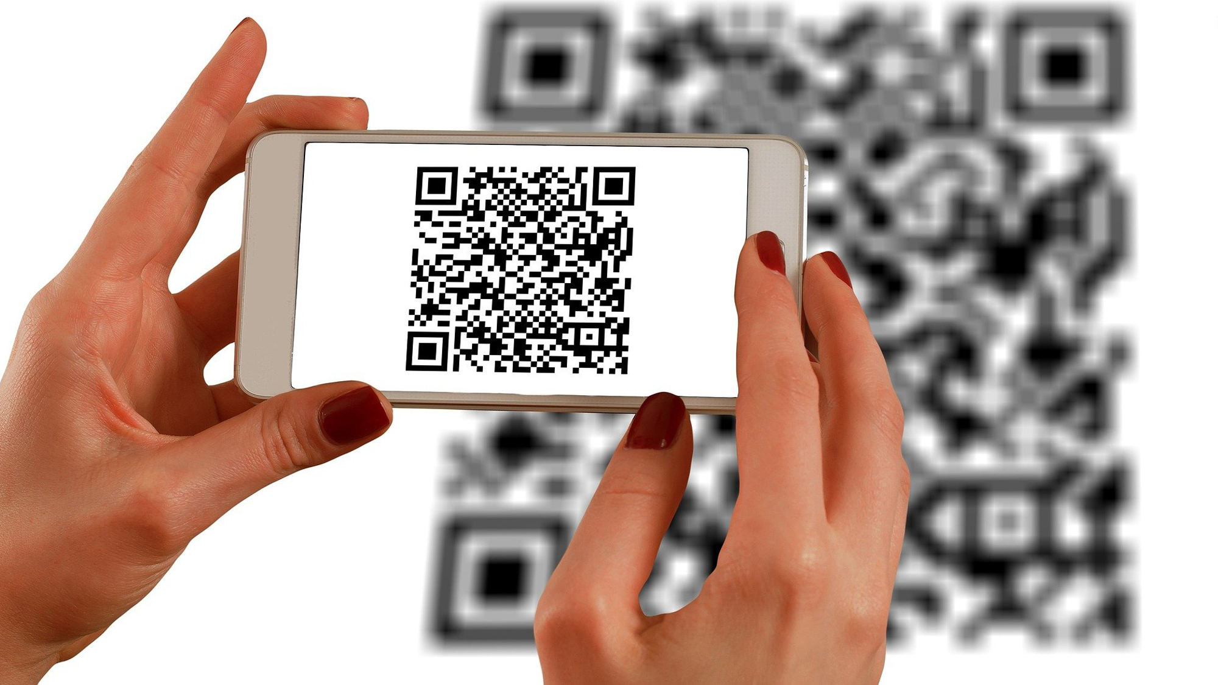
About our Project
The goal is to implement a secure transaction authentication system with the use of QR code
Add password and biometric authentication method
The protocol will need to be executed between a web interface and an application on a mobile device (project requirement)
Notes:
Belinda So now that we understood the topic, the team needed to come up with an idea to incorporate the things that were previously mentioned.
Our aim is to design and develop a secure transaction authentication method with the use of QR code. To achieve this, we will need to use a mobile device with a qr code scanner along with a password and biometrics authentication method.
This protocol will need to be executed between a web interface and a mobile app, which is a project requirement.

Slide 5
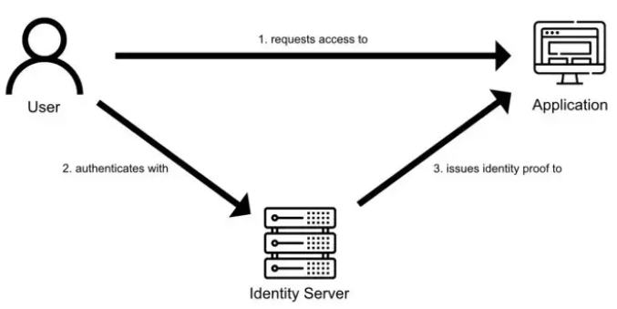
Research:
What is a QR code and how does it work?
How to make the QR scanner and generate QR
How to create a validation system with QR
Similar multi-factor transaction authorisation
OAuth2
Notes:
Belinda For our research, the team looked at what a QR is and how it works, as well as how we can create a QR scanner and generate our own QR codes. We also explored ways to create a validation system using QR for authentication purposes. The team also looked at similar multi-factor transaction authorisation such as OAuth2.

Slide 6
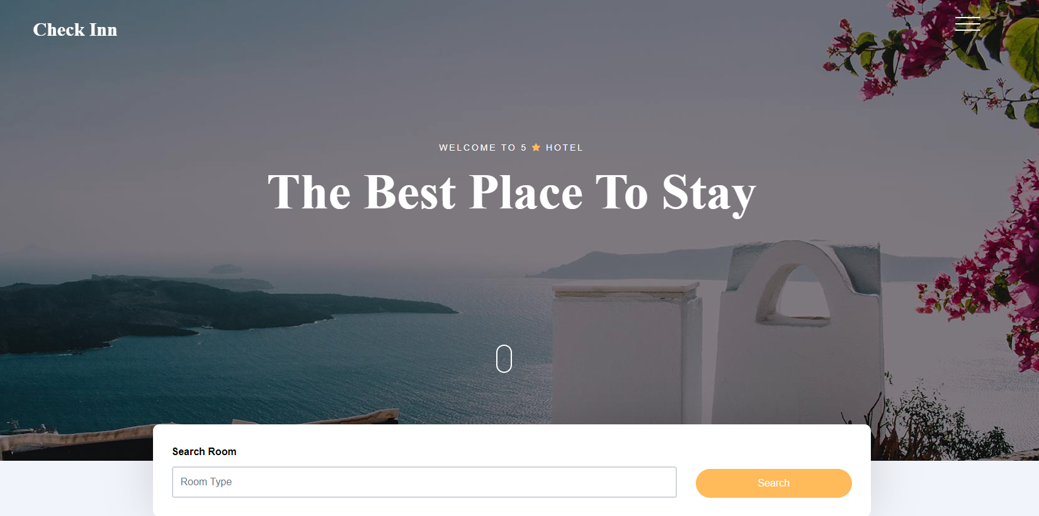
Idea: Hotel Booking Service Provider - Check Inn
Check Inn is a platform that will allow the Customers to make a booking via our website and allow them to validate themselves upon check in and simply scan a QR code to access their booked room
✔ One stop check in for Customer
✔ Customer gain exclusive deals by signing up
✔ Hotel Operators will join our platform in order to get personalised data of the customers who book a hotel via our platform
Notes:
Belinda - 4 mins
Our team decided to create a Hotel Booking Service Provider, which we call, Check Inn.
Check Inn is a platform that will allow Customers to make a booking via our website and let them to validate themselves upon check by simply scanning a QR code to access their booked room. The goal of this is to make it a fast and efficient way of checking in, while reducing the time needed when checking in to a hotel room.
The customers who use sign up to out platform will be able to gain exclusive deals while the hotel operators who onboard our platform will be given access to the customised data from the customers to booked a hotel room from us.
Now, i will be handing my time over to Angela who will be explaining how our platform and system will work.

Slide 7
Idea: Hotel Booking Service Provider - Check Inn
How to book a room if you are a Customer?
Access the website
Login to account
Select any available room/suites
Customer enters his/her particulars to reserve the room
Customer makes payment to reserve the room
Customer’s room booking is confirmed
✔ One stop destination to get best pricing
✔ Fast signup and creation for new account sign up
✔ View all various types of rooms and pricing available
✔ Flexible online payment and immediate confirmation
Notes:
Angela
Thank you, Belinda. Now, I will be talking about how to book a room if you are a customer. First, the customer can access the website and log in to the account which we assume that the account is created. After validating the account, the customer will be redirected to the website booking page where he/she can select any available rooms/suites. Once the customer chooses a room or a suite that he/she fancies, the customer enters his/her particulars to reserve the room which will redirect them to the payment page where the customer makes payment to reserve the room. The customer will be prompted with a room booking confirmation once payment is confirmed through the View Booking page.
The business outcomes are that for the customers, it is a one-stop hotel service provider to get the best pricings of 5 star hotels. It provides a fast and efficient new account sign up. Customers can view all the various types of rooms and pricing available and lastly, it is a flexible online payment and immediate confirmation which makes it convenient and hassle-free.
As for the hotels, they can gain a wider customer base and boost their business reach while minimizing the marketing cost because the platform has a wide user base and offer advanced search and filtering options, making it easier for potential customers to find and book hotel accommodations. By partnering with our platform, hotels can tap into their customer base and increase chances of getting booked. Lastly, for the hotel service provider (Check Inn), by providing excellent service and memorable experiences to foster customer loyalty. Repeat business from satisfied customers reduced the need for extensive marketing efforts and lower customer acquisition costs. Loyal customers will have.

Slide 8
Idea: Hotel Booking Service Provider - Check Inn
How will the Customer check in after booking?
Go to the hotel room which you booked
Login to our mobile application
Click on the scanner in the app and scan the QR code outside the hotel room
Customer will be prompted to scan his/her biometrics
Validate biometrics and booking
Door unlocks after successful validation
✔ Fast and efficient way of checking in
✔ Remove the use of physical keys
✔ Addition of biometrics to secure the authorisation process
✔ QR Code used to unlock the room door and validate booking
✔ Customer can benefit from getting Hotel booking discounts
Notes:
Angela
After booking the room/suite and getting the room booking confirmation, the customer goes to the hotel room and log in to the mobile application where the customer clicks on the scanner in the application and scan the QR code outside the hotel room door. Customer will be prompted to scan his/her biometrics to validate the booking, which the door unlocks after successful validation. It is a fast and efficient way of checking in as we remove the element of physical key use along with the biometrics element to secure the authorisation process with the QR code used to unlock the room door and validate booking. For the hotel, there are benefits such as reduced logistics, decreased manpower requirements and no key cards to manage. As for the customers, they experience an advantage of a faster check-in process, allowing them to access their rooms quickly and getting hotel booking discounts when they visit Check Inn. Now, I will be moving on to how does the Hotel Operator get the QR code.

Slide 9
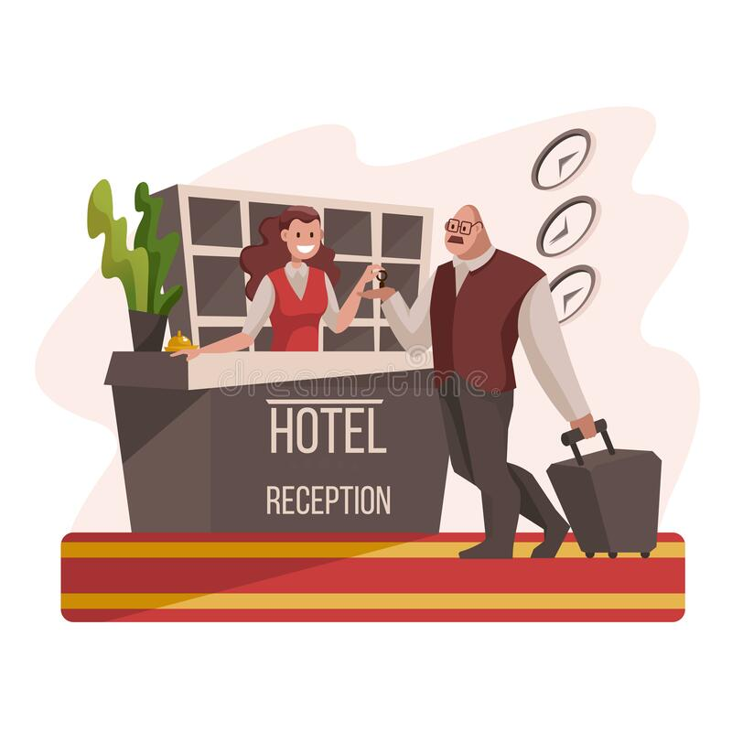
Idea: Hotel Booking Service Provider - Check Inn
How will the hotel operator get the QR code?
Login to our website
Click on “QR Codes”
The page will display the hotel room numbers and the QR Codes.
Hotel Operator can paste the QR codes outside the room
✔ Digitalise and do not need to provide physical key.
✔ Have a digital master access to unlock all room
✔ Customer personal details
✔ Minimise manpower
Notes:
Angela
The hotel operator gets the QR code by logging into the website and clicking on the “QR Codes” button where the page will display all the hotel room numbers and the QR codes. The hotel operator can paste the QR codes outside the room for the Customer to scan using our Mobile Application to unlock the hotel room door. The benefit of this system is that it is digitalise and therefore, there is no need to provide a physical key for the Customers. The hotel operator has a digital master access to unlock all the rooms and they have the customer’s personal details in the database. The use of a keyless authentication room helps to minimise manpower to cut cost for the hotel operators. Now, I will be touching on the special features.

Slide 10

Special Features
Data Security:
Role-Based Access: Stringent access control, only System Admins will have full rights
Two Factor Authentication (2FA) - Biometrics
Notes:
Angela
The special features that we added is Data Security where we implement encryption on all user data provided to ensure authentication and a sense of reliability. Under role-based access control, different roles are defined with a specific set of permissions and privileges. In this scenario, system administrators are granted the highest level of access to user accounts and user profiles. By enforcing stringent access control, the system ensures unauthorized users cannot perform actions beyond the assigned roles. This helps to minimize the risk of unauthorized access, data breaches and system functionalities misuse. This enhances security by limiting potential damage that are caused by unauthorized users. Two factor authentication that we used is biometrics, the fingerprint as it is unique to each individual and cannot be easily replicated or stolen, to verify the identity of the Customer. Now, I will be passing my time to Jia Hong who will be talking about the user stories.

Slide 11
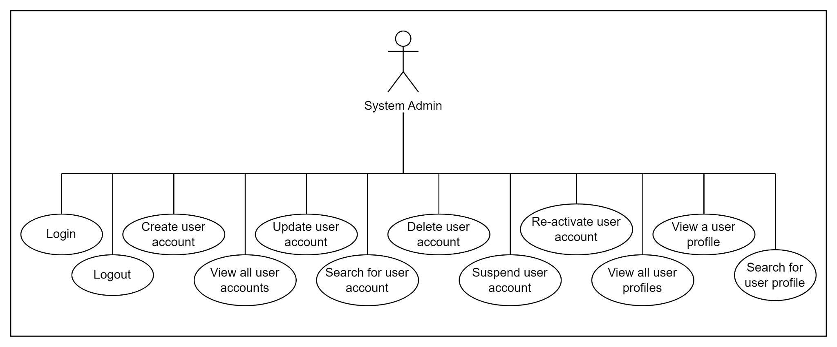
User Story and Use Cases for System Admin
Notes:
JiaHong

Slide 12
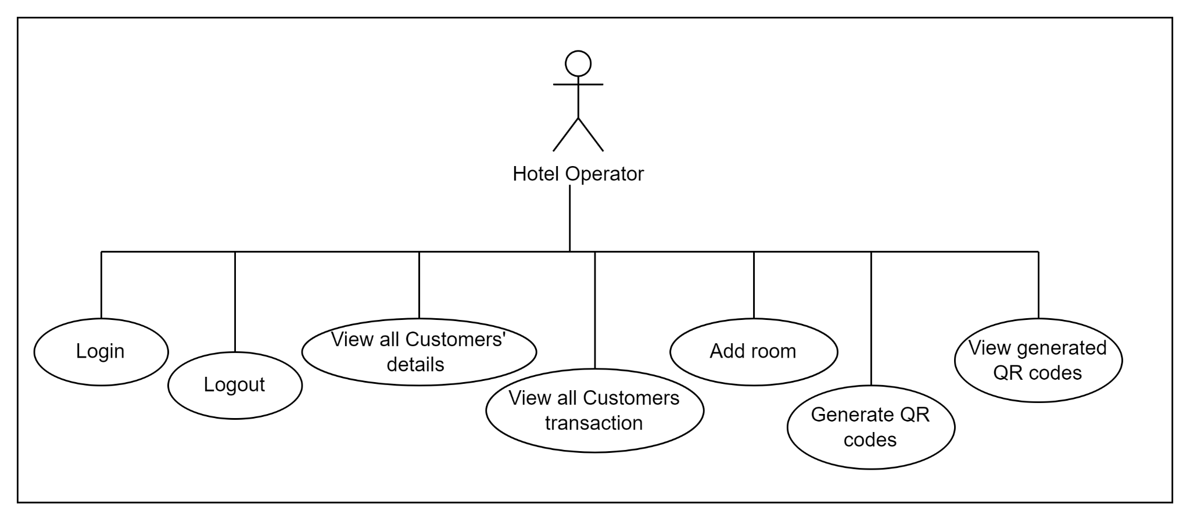
User Story and Use Cases for Hotel Operator
Notes:
JiaHong

Slide 13
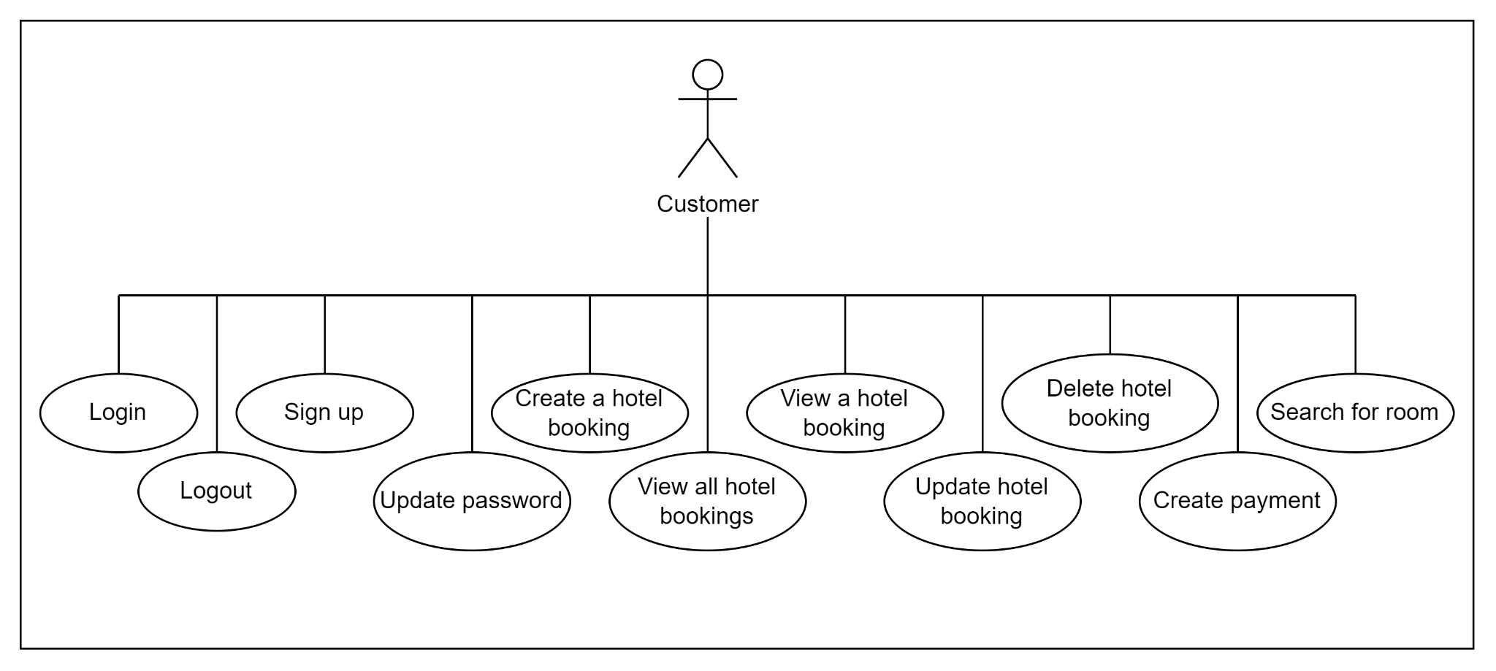
User Story and Use Cases - Customer (Website)
Notes:
Benisha

Slide 14
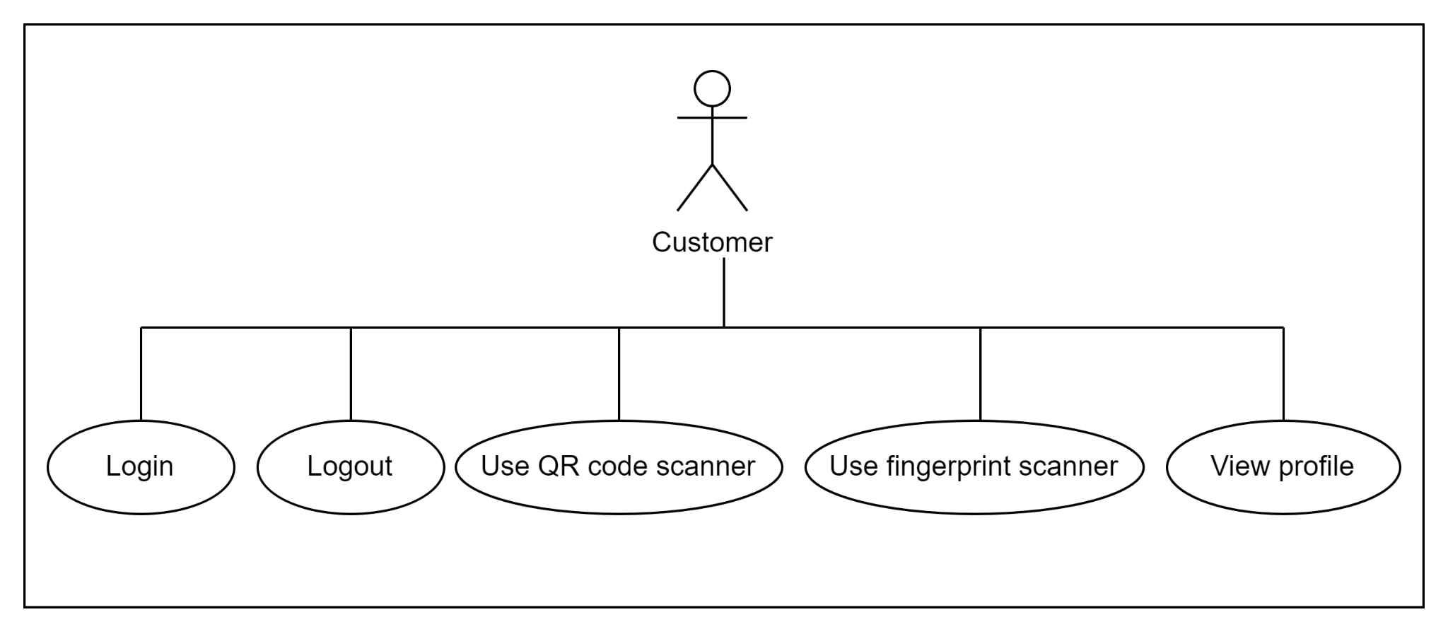
User Story and Use Cases - Customer (Mobile Application))
Notes:
Benisha

Slide 15
Time for Demonstration of
1) Administrative Website
2) CheckInn Website
3) CheckInn Android Application

Slide 16
Hotel Room Door
A IOT device is installed in the wall and it is wired to an electric door strike lock.
The IOT device is connected to the online server through the Wi-Fi network.
The QR code will be pasted on the IOT device.
Once the customer is authenticated to unlock the hotel room, it will update the database of the unlock door status from closed to open.
Once the IOT device detects the open status from the database, it will send a signal to the electric door strike lock to unlock the door.

Slide 17

Any questions?

Slide 18

Thank You

